Slide 1
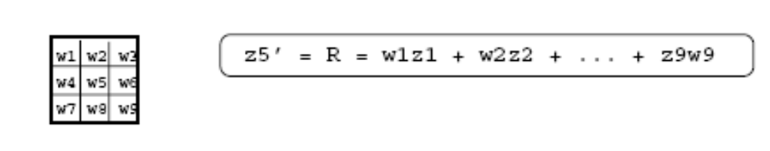
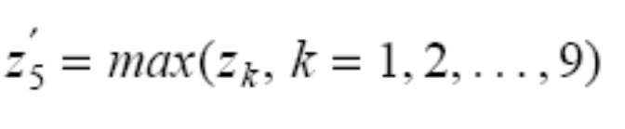
Linear vs Non-Linear
Spatial Filtering
A filtering method is linear when the output is a weighted sum of the input pixels.
Methods that do not satisfy the above property are called non-linear.
COMSATS Institute of Information Technology, Lahore Digital Image Processing CSC331

Slide 2
Example
10
5
3
0
0
0
4
6
1
0
0.5
8
0
1
1
8
0
1
0.5
Local image neighborhood
mask
Modified image data
COMSATS Institute of Information Technology, Lahore Digital Image Processing CSC331

Slide 3
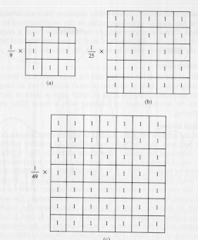
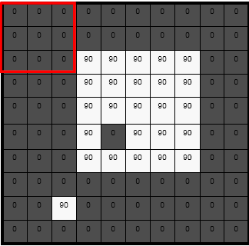
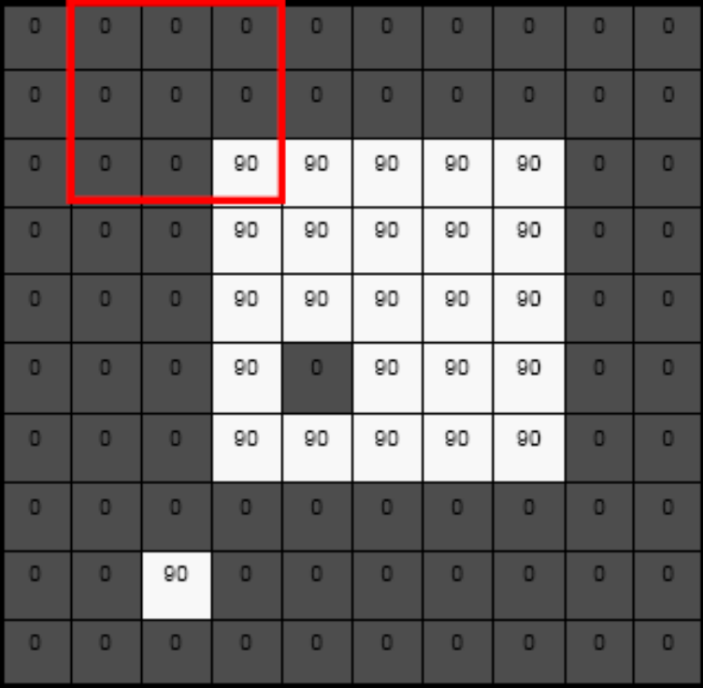
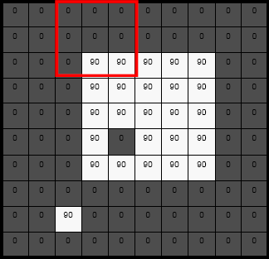
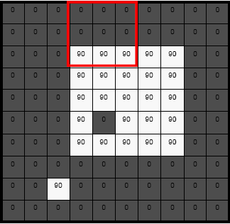
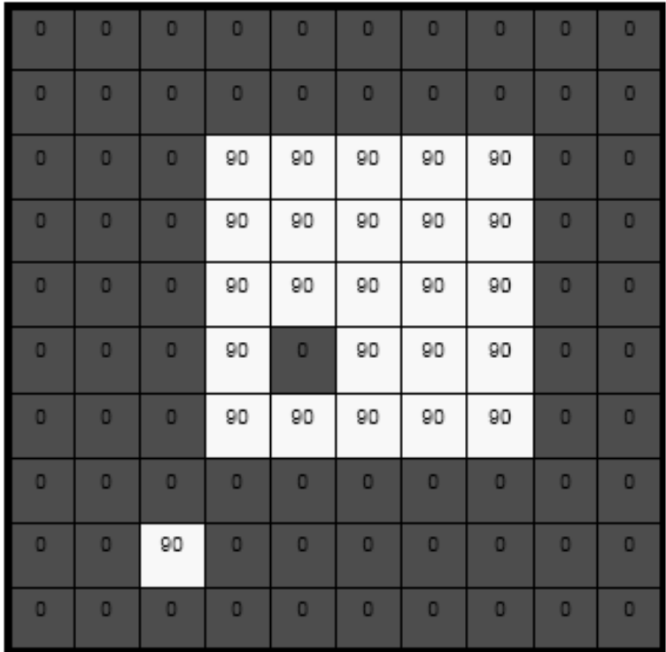
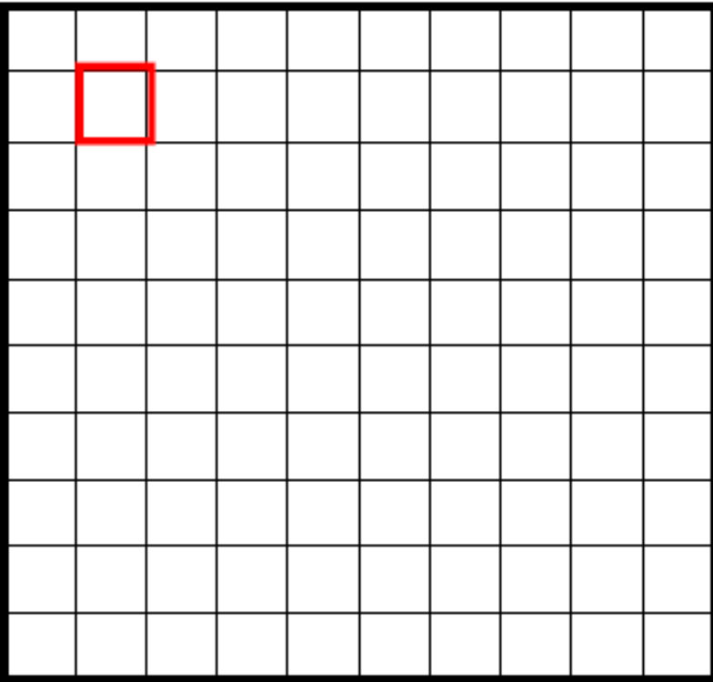
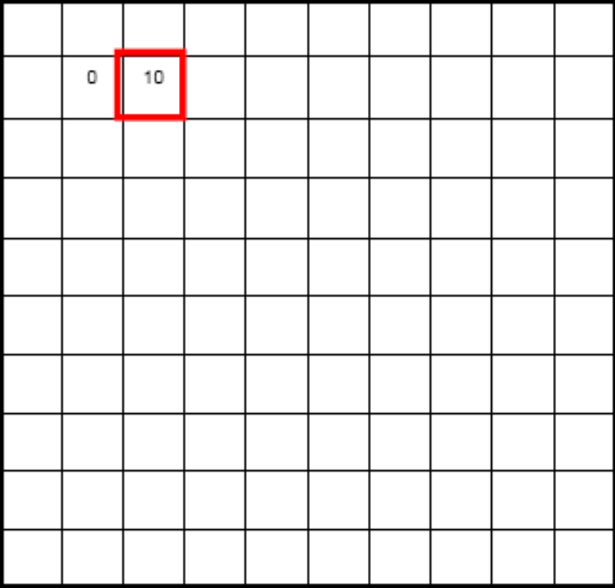
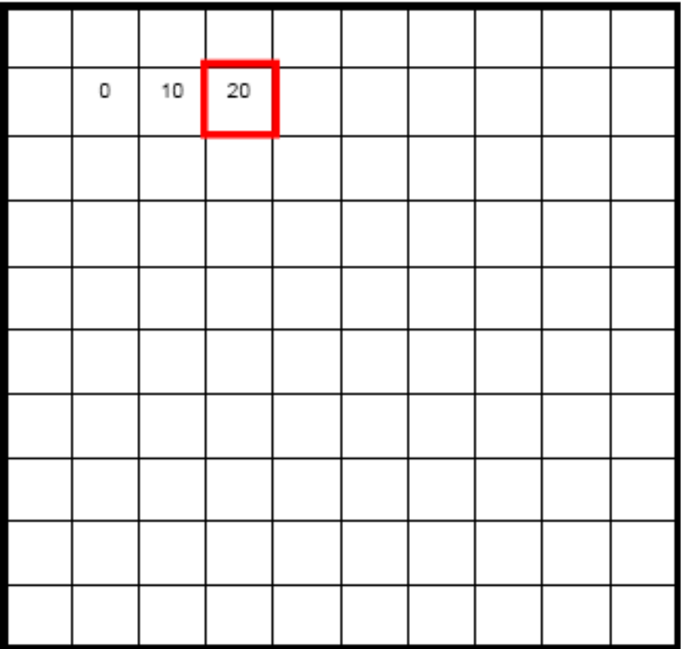
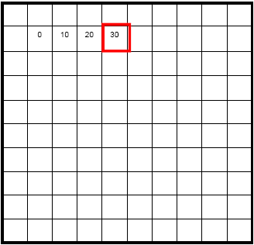
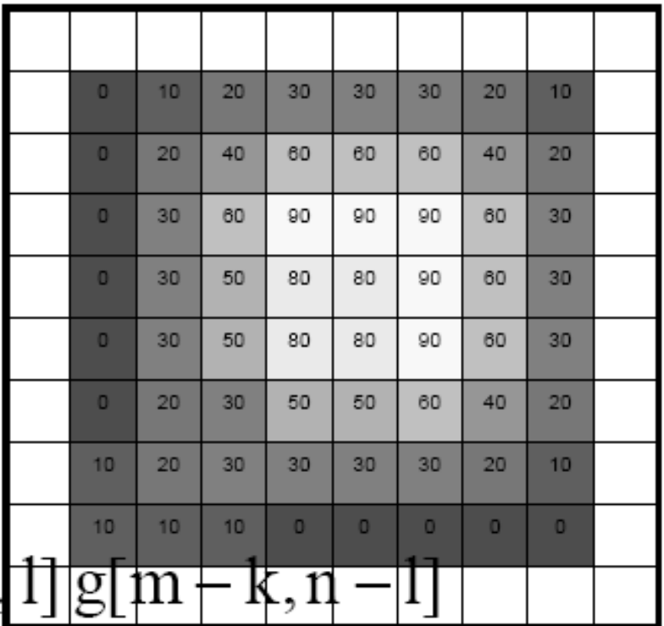
Example
COMSATS Institute of Information Technology, Lahore Digital Image Processing CSC331

Slide 4
Linear Spatial Filtering
Two main linear spatial filtering methods:
  Correlation
  Convolution
COMSATS Institute of Information Technology, Lahore Digital Image Processing CSC331

Slide 5
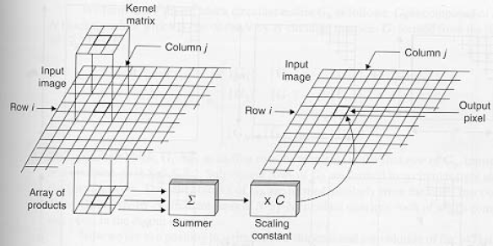
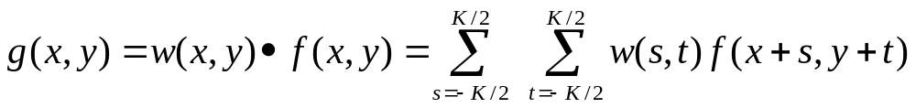
Correlation
w(i,j)
f(i,j)
COMSATS Institute of Information Technology, Lahore Digital Image Processing CSC331

Slide 6
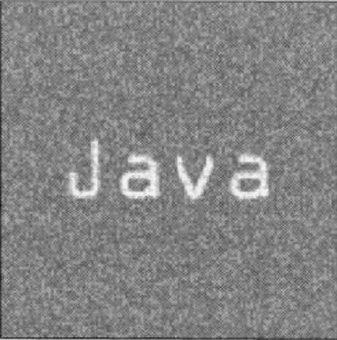
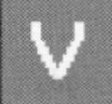
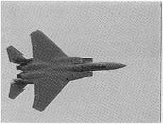
Correlation
Often used in applications where we need to measure the similarity between images or parts of images
(e.g., pattern matching).
COMSATS Institute of Information Technology, Lahore Digital Image Processing CSC331

Slide 7
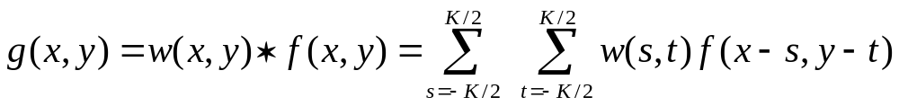
Convolution
Similar to correlation except that the mask is first flipped both horizontally and vertically.
Note: if w(x,y) is symmetric, that is w(x,y)=w(-x,-y), then convolution is equivalent to correlation !
COMSATS Institute of Information Technology, Lahore Digital Image Processing CSC331

Slide 8
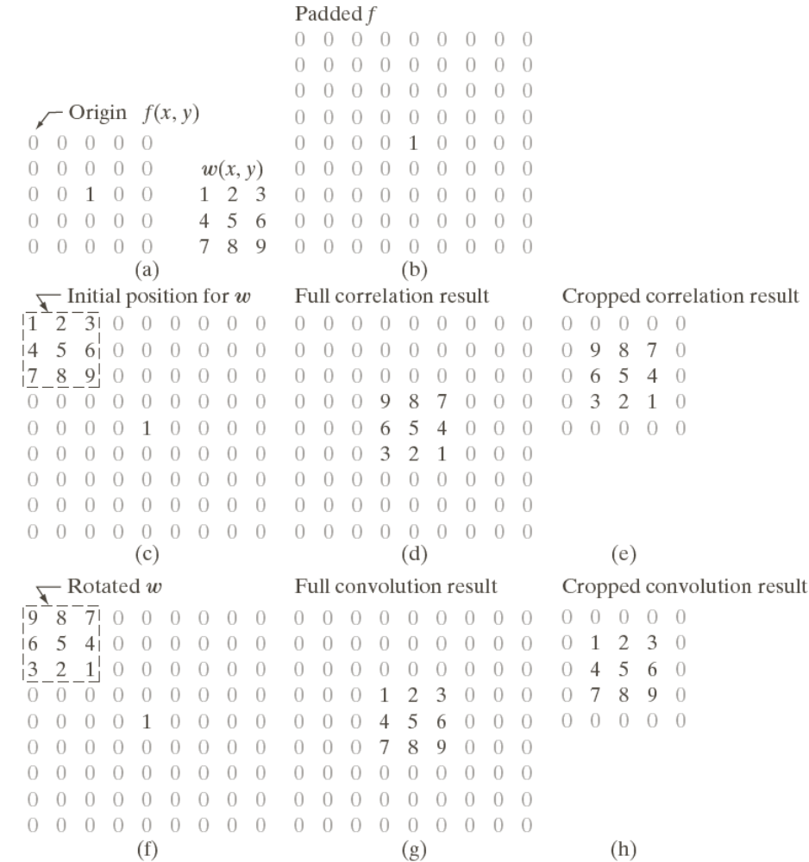
Convolution Vs Correlation
Correlation:
Convolution:
COMSATS Institute of Information Technology, Lahore Digital Image Processing CSC331

Slide 9
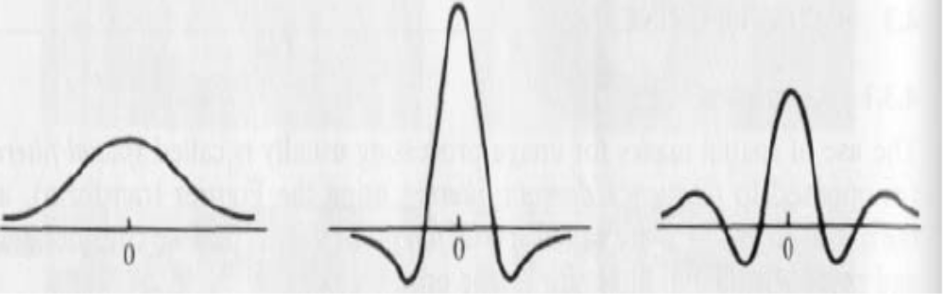
How do we choose the elements of a mask ?
Typically, by sampling certain functions
1st derivative
of Gaussian
2nd derivative
of Gaussian
Gaussian
COMSATS Institute of Information Technology, Lahore Digital Image Processing CSC331

Slide 10
Filters
Smoothing (i.e., low-pass filters)
  Reduce noise and small details.
  The elements of the mask must be positive.
  Sum of mask elements is 1
COMSATS Institute of Information Technology, Lahore Digital Image Processing CSC331

Slide 11
Averaging Filters
COMSATS Institute of Information Technology, Lahore Digital Image Processing CSC331

Slide 12
Filters
Sharpening (i.e., high-pass filters)
  Highlight fine detail or enhance detail that has been blurred.
  The elements of the mask contain both positive and negative weights.
  Sum of the mask weights is 0
1st derivative
of Gaussian
2nd derivative
of Gaussian
COMSATS Institute of Information Technology, Lahore Digital Image Processing CSC331

Slide 13
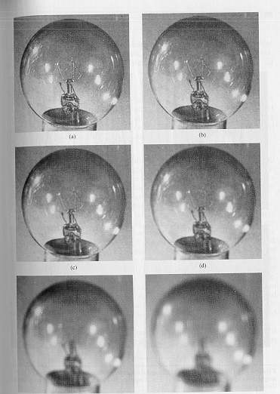
Averaging Filters
Mask size determines the degree of smoothing and loss of detail
original
3x3
5x5
7x7
15x15
25x25
COMSATS Institute of Information Technology, Lahore Digital Image Processing CSC331

Slide 14
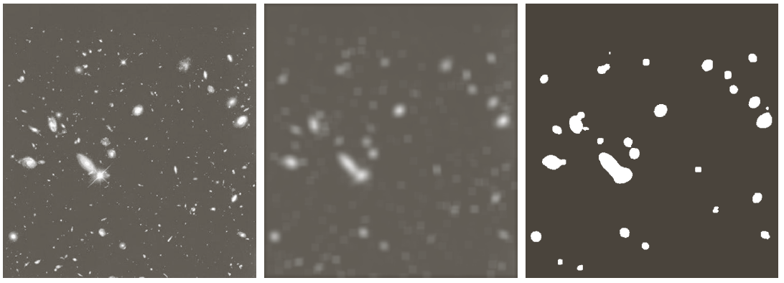
Averaging Filters
Example: extract, largest, brightest objects
15 x 15 averaging
image thresholding
COMSATS Institute of Information Technology, Lahore Digital Image Processing CSC331

Slide 15
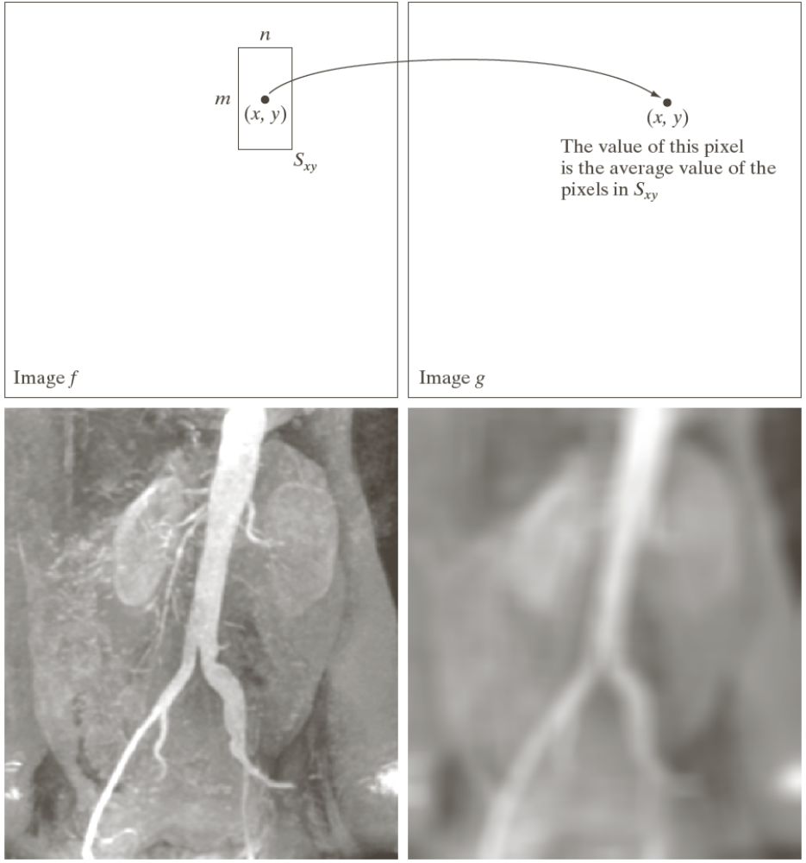
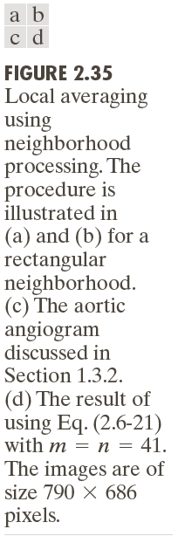
Spatial Operations - Neighborhood Operations
COMSATS Institute of Information Technology, Lahore Digital Image Processing CSC331

Slide 16
Spatial filtering for Smoothing
For blurring/noise reduction;
Blurring is usually used in preprocessing steps,
e.g., to remove small details from an image prior to object extraction, or to bridge small gaps in lines or curves
Equivalent to Low-pass filtering in frequency domain because smaller (high frequency) details are removed based on neighborhood averaging (averaging filters)
Implementation: simplest form: averaging with a square mask (assume m×m mask) with the all coefficients equal to 1/m² (averaging).
Applications: Reduce noise; smooth false contours
Side effect: Edge blurring
COMSATS Institute of Information Technology, Lahore Digital Image Processing CSC331

Slide 17

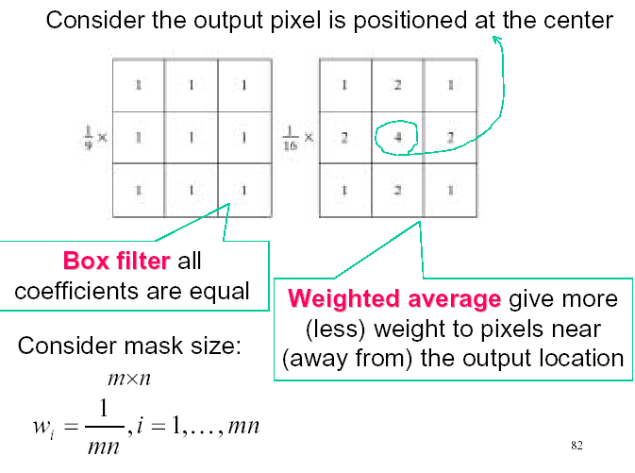
Smoothing filters
COMSATS Institute of Information Technology, Lahore Digital Image Processing CSC331

Slide 18

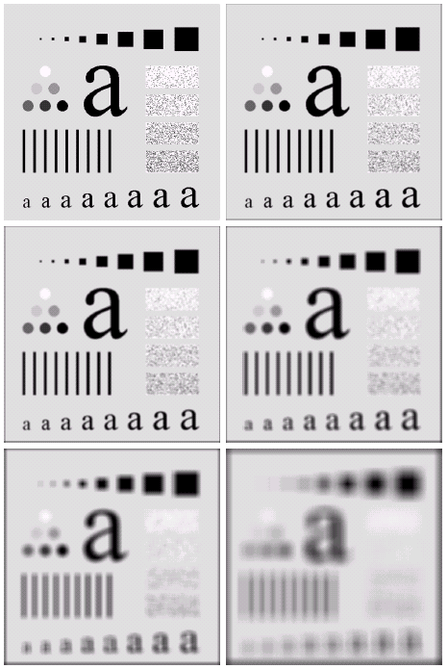

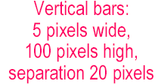


Spatial filtering for Smoothing (example)
COMSATS Institute of Information Technology, Lahore Digital Image Processing CSC331

Slide 19
Spatial filtering for Smoothing (example)
Original image size: 500 x 500
Smoothed by 3 x 3 box filter
Smoothed by 5 x 5 box filter
Smoothed by 9 x 9 box filter
Smoothed by 15 x 15 box filter
Smoothed by 35 x 35 box filter
COMSATS Institute of Information Technology, Lahore Digital Image Processing CSC331

Slide 20
Order-statistics filtering
Nonlinear spatial filters
Output is based on order of gray levels in mask (subimage)
Examples: Median filtering, Max & Min filtering
Median filtering
Assigns the mid value of all the gray levels in the mask to the center of mask;
Particularly effective when
  noise pattern consists of strong, spiky components (impulse noise, salt-and-pepper
  edges are to be preserved
  Force pixels with distinct gray levels to be more like their neighbors
COMSATS Institute of Information Technology, Lahore Digital Image Processing CSC331

Slide 21
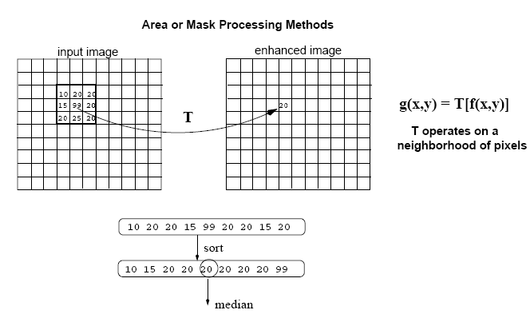
Smoothing Filters (Non-Linear) (Median)
Replace each pixel by the median in a neighborhood around the pixel
COMSATS Institute of Information Technology, Lahore Digital Image Processing CSC331

Slide 22
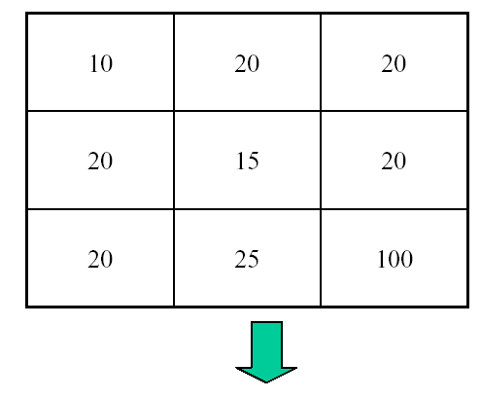
Median Filtering
Output ?
COMSATS Institute of Information Technology, Lahore Digital Image Processing CSC331

Slide 23

Median Filtering (example)
COMSATS Institute of Information Technology, Lahore Digital Image Processing CSC331

Slide 24
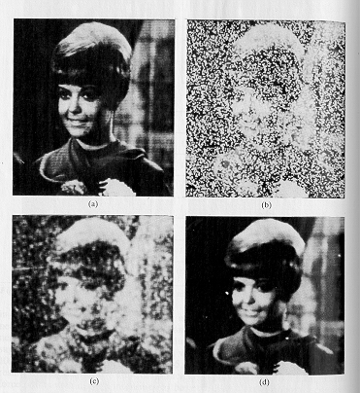
Smoothing Filters (Non-Linear) (Median)
Very effective for removing “salt and pepper” noise (i.e., random occurrences of black and white pixels).
COMSATS Institute of Information Technology, Lahore Digital Image Processing CSC331

